Slide 1



Computing Shortest Path Between Two Nodes
Team Members :
2010030305 – Kollapudi Jeevan Kumar
2010030300 – Indla Harshitha
2010030262 – P . Arun Tej

Slide 2
Abstract :
The shortest path problem based on the data structure has become one of the hot research topics in graph theory.
There are three algorithm widely used for this.
As the basic theory of solving this problem, Dijkstra algorithm has been widely used in engineering calculations.

Slide 3
Introduction :
An algorithm that is designed essentially to find a path of minimum length between two specified vertices of a connected weighted graph.
In computer networks, the shortest path algorithms aim to find the optimal paths between the network nodes so that routing cost is minimized.
They are direct applications of the shortest path algorithms proposed in graph theory.

Slide 4
Literature review :
A shortest-path algorithm finds a path containing the minimal cost between two vertices in a graph.
A plethora of shortest-path algorithms is studied in the literature that span across multiple disciplines.
There is no one general algorithm that is capable of solving all variants of the shortest-path problem due to the space and time complexities associated with each algorithm.

Slide 5
Methods :
There are three methods to find the shortest path between nodes.
Dijikstra Algorithm
Bellmen Algorithm
Floyed Warshall Algorithm

Slide 6
Dijkstra’s Algorithm :
Dijkstra’s Algorithm is a greedy algorithm for solving single source shortest path problem that provides us with the shortest path from one particular source node to all other nodes in the given graph.

Slide 7
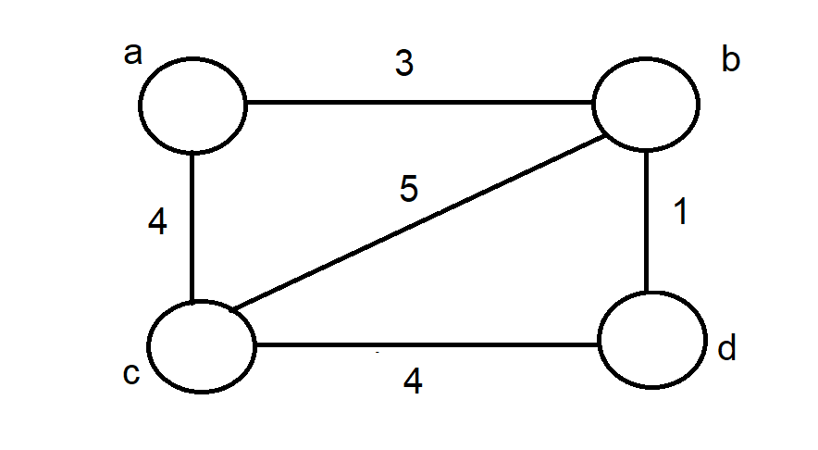
Rules of Dijkstra’s Algorithm :
It can be applied on both directed and undirected graph.
It is applied on weighted graph.
For the algorithm to be applicable the graph must be connected.
Dijkstra’s algorithm does not work for graph with negative weight edges.
For graphs with negative weight edges, Bellman ford algorithm can be used.
In Dijkstra’s algorithm always assign source vertex to zero distance.
Assign every other node a tentative distance.

Slide 8
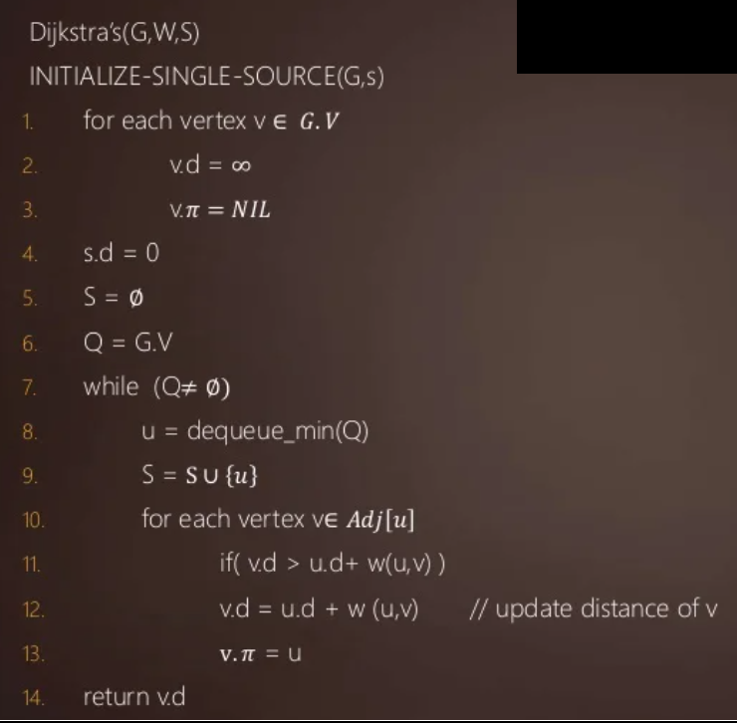
Dijkstra’s Algorithm :

Slide 9
BellMan – Algorithm :
The Bellman – ford algorithm is an algorithm that computes shortest paths from a single source vertex to all of the other vertices in a weighted digraph.
Negative edge weights are found in various applications of graphs, hence the usefulness of this algorithm.
It is similar to Dijkstra’s algorithm but it can work with graphs in which edges can have negative weights.
Negative weight edges can create negative weight cycles i.e. a cycle which will reduce the total path distance by coming back to the same point.
Shortest path algorithm like Dijkstra’s Algorithm that aren’t able to detect such a cycle can give an incorrect result because they can go through a negative weight cycle and reduce the path length.

Slide 10
Uses of Algorithm :
This algorithm can be used on both weighted and unweighted graphs.
Like Dijkstra’s shortest path algorithm, Bellman – Ford algorithm is guaranteed to find the shortest path in a graph.
Though it is slower than Dijkstra’s algorithm, Bellman – Ford is capable of handling graphs that contain negative edges weights, so it is more versatile.

Slide 11
Algorithm :
for v in V:
v.distance = infinity
v.p = None
source.distance = 0
for i from 1 to |V| - 1:
for (u, v) in E:
relax(u, v)

Slide 12
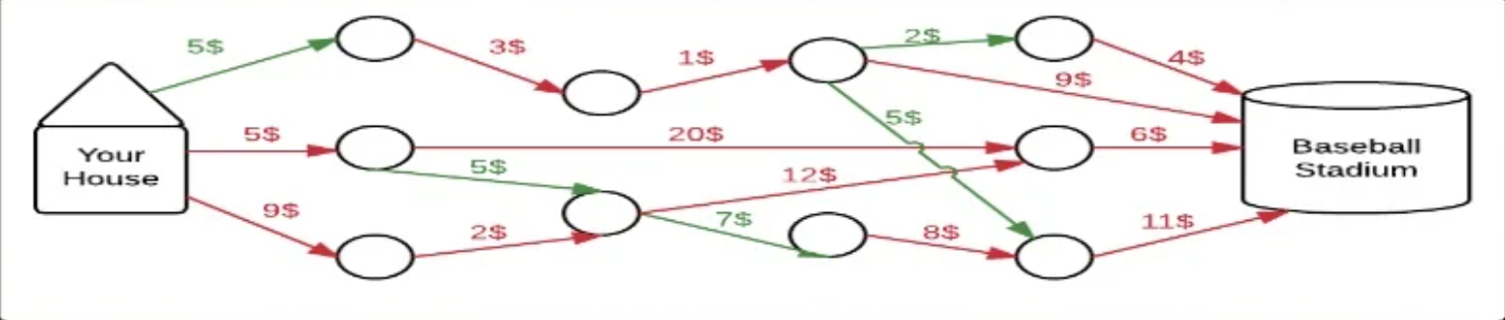
Relaxation Equation :
Relaxation is the most important step in Bellman – Ford.
It is what increases the accuracy of the distance to any given vertex.
Relaxation works by continuously shortening the calculated distance between vertices comparing that distance with other known distances.

Slide 13
Example :
Take the base ball example from earlier. Let’s say I think the distance to the baseball stadium is 20 miles. However, I know that the distance to the corner right before the stadium is 10 miles, and I know that from the corner to the stadium, the distance is 1 mile. Clearly, the distance from me to the stadium is at most 11 miles. So, I can update my belief to reflect that. That is one cycle of relaxation, and it’s done over and over until the shortest paths are found.

Slide 14
Relax Equation :
relax(u, v):
if v.distance > u.distance + weight(u, v):
v.distance = u.distance + weight(u, v)
v.p = u

Slide 15
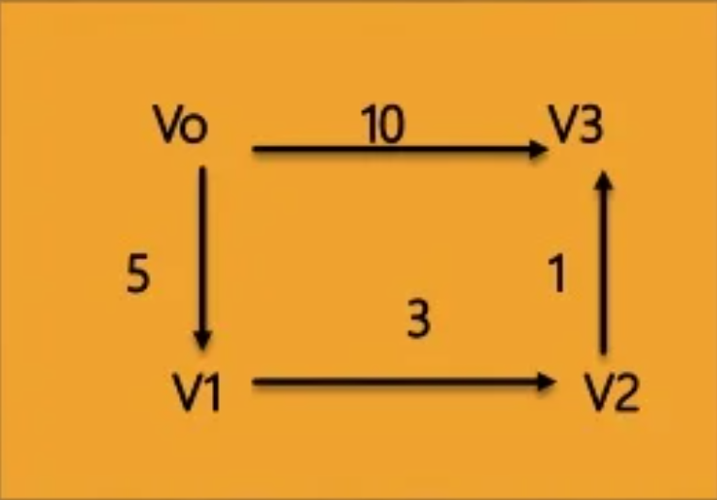
Floyed Warshall Algorithm :
Floyed Warshall Algorithm is an algorithm for finding shortest paths in a weighted graph.
The Graph may be weighted with positive or negative edge weights.
The graph may be directed or undirected.
If a node has not a direct path or link to any other node then the distance between these nodes are infinite.
If only one path between the two nodes or vertices then it is said to be the shortest distance.
This distance of a vertex to itself is 0.

Slide 16
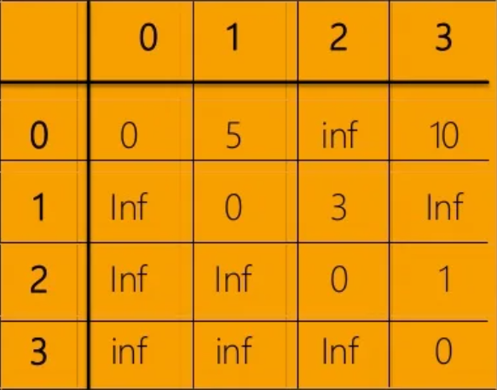
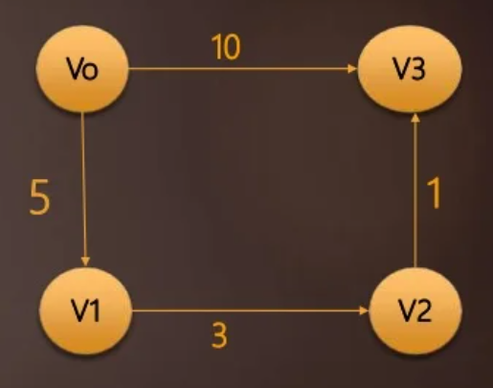
Example :

Slide 17
Results :
In graph theory, the shortest path problem is the problem of finding a path between two vertices (or nodes) in a graph such that the sum of the weights of its constituent edges is minimized.
The problem of finding the shortest path between two intersections on a road map may be modeled as a special case of the shortest path problem in graphs, where the vertices correspond to intersections and the edges correspond to road segments, each weighted by the length of the segment.

Slide 18
Discussion :
The shortest path problem is about finding a path between 2 vertices in a graph such that the total sum of the edges weights is minimum.
This problem could be solved easily using Breadth-first search (BFS) if all edge weights were, but here weights can take any value.

Slide 19
Application of Shortest Path Algorithm :
It is used in Google Map.
It is used in finding Shortest Path.
It is used in geographical Maps.
To find locations of Map which refers to vertices of graph.
Distance between the location refers to edges.
It is used in IP routing to find Open shortest Path First.
It is used in the telephone network.

Slide 20
Conclusion :
This are the algorithms for finding the shortest paths between nodes in a graph, which may represent, for example, road networks.
So, at the minimum we can find our home quickly if we are lost in the city, but have a map with intermediate stops & distances between them in it, and if we can find where we are positioned at, to start from.

Slide 21


